Slide 1
Pfizer
Data Lake and Analytics Immersion Day
Injae Kwak - Solutions Architect

Slide 2

Data Continues to Grow
Data volumes are growing faster than the ability to analyze the data
New types of data cannot be analyzed in context with data in the data warehouse
Users and applications need faster data ingest & analytics results
Notes:
The volume, variety, and velocity of data continues to escalate.
Data volumes are growing fast. With on-premises data warehouses, capacity planning needs to occur far in advance of data growth. Once new capacity is purchased, utilization remains low until the data grows. As the data volume approaches capacity, then performance slows, and users become unhappy.
Unstructured data is growing even faster than structured data. With the structured nature of a data warehouse, analyzing unstructured data becomes a big challenge.
The pace of business continues to accelerate, and business users want analytics results as soon as possible. They don’t want to wait for daily ingest, or longer for new data sources. Also, business applications need to query data in near real-time.

Slide 3
Traditionally, Analytics Looked Like This
On-premises
Relational data
Terabyte to Petabyte scale
Schema defined prior to data load
Operational reporting and ad hoc
Large initial capex + $10K–$50K / Terabyte / Year
Difficult and slow to scale
Business Intelligence
Data Warehouse
OLTP
ERP
CRM
LOB
Notes:
Wikipedia: In computing, a data warehouse (DW or DWH), also known as an enterprise data warehouse (EDW), is a system used for reporting and data analysis, and is considered a core component of business intelligence.^{[1]} DWs are central repositories of integrated data from one or more disparate sources. They store current and historical data and are used for creating analytical reports for knowledge workers throughout the enterprise. Examples of reports could range from annual and quarterly comparisons and trends to detailed daily sales analysis.
Organizations need to get insights from their data to support better decision making. A proven approach to gain these insights uses reports, dashboards, and analytics tools powered by data warehouses that store consolidated data optimized to deliver results quickly to a broad set of users.
On-premises data warehouses are failing to keep pace with exploding data volumes, new types of data, and the need to analyze data in real-time. On-premises data warehouses require significant upfront investment for hardware, licensing, and ongoing operational costs. Data capacity needs to be planned many months to a year or more in advance, to allow time to purchase and install necessary resources. Once installed, the added capacity is underutilized until data volumes catch up. Then, as data volumes grow, high utilization causes query performance to suffer, which becomes a pain point for users. This cycle of trying to balance capacity (scale) and performance repeats again and again.
Upgrades and patches to hardware and software must be carefully planned and coordinated to minimize downtime. DBAs must be highly skilled with specific data warehouse software to constantly tune performance, maintain the system, and manage backups. Also, since the data structure within a data warehouse is highly controlled, DBAs are reluctant and slow to add new data sources and new tables, causing delays for users who want to analyze the new data.
At the same time, organizations need to store and analyze exponentially increasing volumes of unstructured data, further increasing the costs and difficulties of analytics. The data lake, a less structured data repository that offers highly scalable storage at a lower cost than the data warehouse, has emerged as a complementary technology. Managing a data lake on-premises requires yet more expenses for hardware, licensing, and ongoing operational costs, and yet another team with a different set of skills. Data in the data lake is then analyzed in isolation from the data in the data warehouse.
Most cloud-based data warehouses fail to allow their users to query data across their data warehouse and data lake without moving the data back and forth. As data volumes grow, this approach no longer works. The lack of seamless query across all data, structured and unstructured, stored in a data warehouse or a data lake, limits the insights obtained from analyzing all available data together.

Slide 4
Legacy Architecture Models Lead to Dark Data Traditional data warehouses cannot keep pace with data growth
Dark Data
is not available for analysis
Sources:
Gartner: User Survey Analysis: Key Trends Shaping the Future of Data Center Infrastructure Through 2011 IDC: Worldwide Business Analytics Software 2012–2016 Forecast and 2011 Vendor Shares
Notes:
Data is a powerful and pervasive resource – it is everywhere, and it is used in every aspect of your business.
including back-office systems of record, systems of insight that inform decision making and systems of engagement that shape customer relationships. However, few organizations have the ability to harness its full potential.
The mismatch between “all data” and the subset of data available for analysis has always existed.
But as you can see, the gap is widening at an accelerating pace – the vast majority of data is just not available, so it is not analyzed.
That means that your business is making decisions based on incomplete data and incomplete analysis.

Slide 5
Alternatively…

Slide 6
Amazon Redshift 10x faster at 1/10th the cost
Fast
Simple
Cost-effective
Delivers fast results for all types of workloads
Create and start using a data warehouse in minutes
No upfront costs, start small, and pay as you go
Scalable
Integrated
Secure
Gigabytes to petabytes
to exabytes
Integrated with S3 data lakes,
AWS services and third-party tools
Audit everything; encrypt data end-to-end; extensive certification and compliance
Notes:
We begin with data warehousing. Amazon Redshift is a fast, scalable, fully managed data warehouse that makes it easy and cost-effective to analyze all your data using standard SQL and your existing Business Intelligence (BI) tools. It allows you to run complex analytic queries against petabytes of structured data, using sophisticated query optimization, columnar storage on high-performance local disks, and massively parallel query execution. Most results come back in seconds. With Amazon Redshift, you can start small for just $0.25 per hour with no commitments and scale out to petabytes of data for $250-$333 per uncompressed terabyte per year, less than a tenth the cost of traditional solutions.
Fast - Amazon Redshift delivers 10x better performance than traditional on-premises data warehouses. Redshift is fast for all types of workloads, ranging from short-running queries to complex, long-running queries on trillions of rows of data. Redshift leverages a massively parallel processing (MPP) architecture to deliver high throughput, and uses machine learning and sophisticated query management for faster processing.
Simple - With Amazon Redshift, you can create and start using a new data warehouse in minutes. Redshift automates most of the common administrative tasks to manage, monitor, and scale your data warehouse. Redshift automatically replicates and backs up all your data for reliability. Functional enhancements are released transparently, eliminating the need to schedule and apply upgrades and patches.
Cost-Effective - There are no upfront costs, and you only pay for what you use. Start small for just $0.25 per hour with no commitments. For larger workloads, pay only $1,000 per terabyte per year with a 1- or 3-year commitment using Reserved Instances. With data compression, you pay only $250-$333 per uncompressed terabyte per year. When querying data in Amazon S3, you only pay for the queries you run based on the amount of data scanned.
Scalable - Amazon Redshift provides petabyte-scale data warehousing and exabyte-scale data lake analytics, together, in one service. Resize your Redshift cluster with a few clicks in the AWS console or a simple API call. Run queries against exabytes of data in S3.
Integrated - Quickly build an integrated data lake and analytics solution with Amazon Redshift as your data warehouse, Amazon S3 as your data lake store, AWS Glue as your data catalog, and Amazon QuickSight as your business intelligence application.
Secure - Many enterprises in financial services, healthcare, retail, and government trust Amazon Redshift to run mission critical workloads and keep their data secure. Redshift is compliant with SOC1, SOC2, SOC3, PCI DSS Level 1 requirements, and FedRAMP. Redshift is a HIPAA eligible service, with BAA available from AWS.

Slide 7










Origins of Amazon Redshift
Amazon SWF
Amazon VPC
IAM
Amazon EC2
Columnar
MPP
OLAP
PostgreSQL
Amazon Redshift
Amazon S3
AWS KMS
Amazon
Route 53
Amazon
CloudWatch

Slide 8

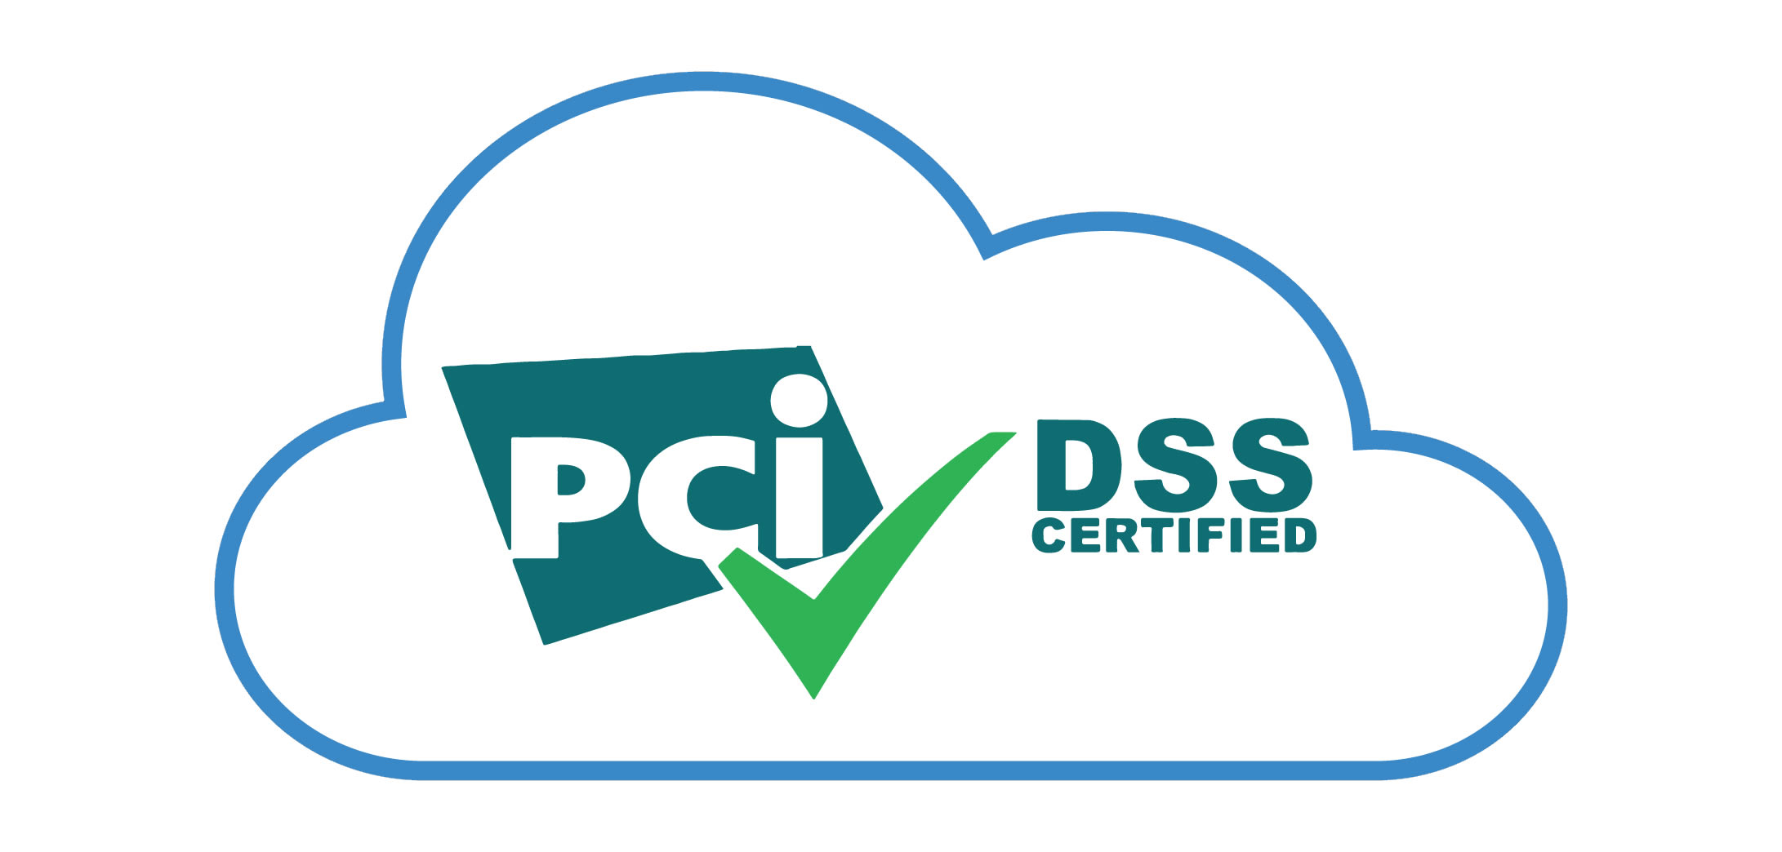
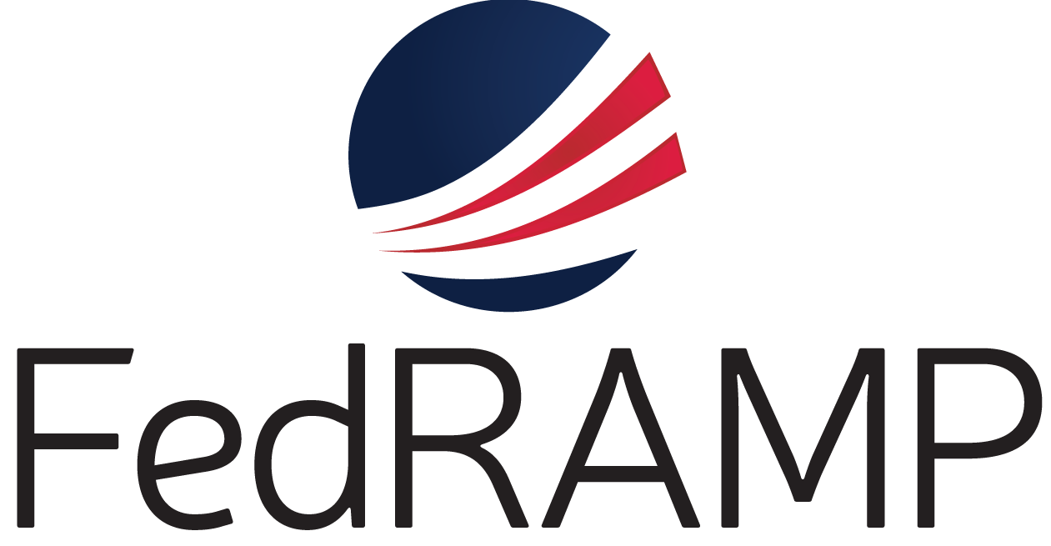

Amazon Redshift is Secure Security is Built-in
Customer VPC
SQL Clients/BI Tools
End-to-end data encryption
Amazon VPC for network isolation
Audit logging and AWS CloudTrail integration
Communicate event-specific notifications via email, text message, or call with Amazon SNS
Certifications and compliance include
SOC 1/2/3, PCI-DSS, FedRAMP, HIPAA
JDBC/ODBC
Leader Node
Internal VPC
128GB RAM
16 cores
10 GigE
(HPC)
16TB disk
Compute Node
Compute Node
Compute Node
128GB RAM
128GB RAM
128GB RAM
16 cores
16 cores
16 cores
16TB disk
16TB disk
16TB disk
S3
Notes:
Encryption to secure data at rest - All blocks on disks & in Amazon S3 are encrypted using SSE, AWS KMS, AWS CloudHSM or your on-premises HSMs
Block key, Cluster key, Master key (AES-256)
On-premises HSM & AWS CloudHSM support
Enforce SSL to secure data in transit using ECDHE perfect forward encryption
Amazon VPC for network isolation. Amazon Redshift leader node in your VPC. Compute nodes in private VPC. Spectrum nodes in private VPC, store no state.
Communicate event-specific notifications via email, text message, or call with Amazon SNS
All API calls are logged using AWS CloudTrail integration
All SQL statements are logged within Amazon Redshift
Compliance: SOC 1/2/3, PCI-DSS, FedRAMP, BAA

Slide 9











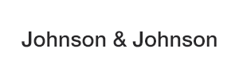







































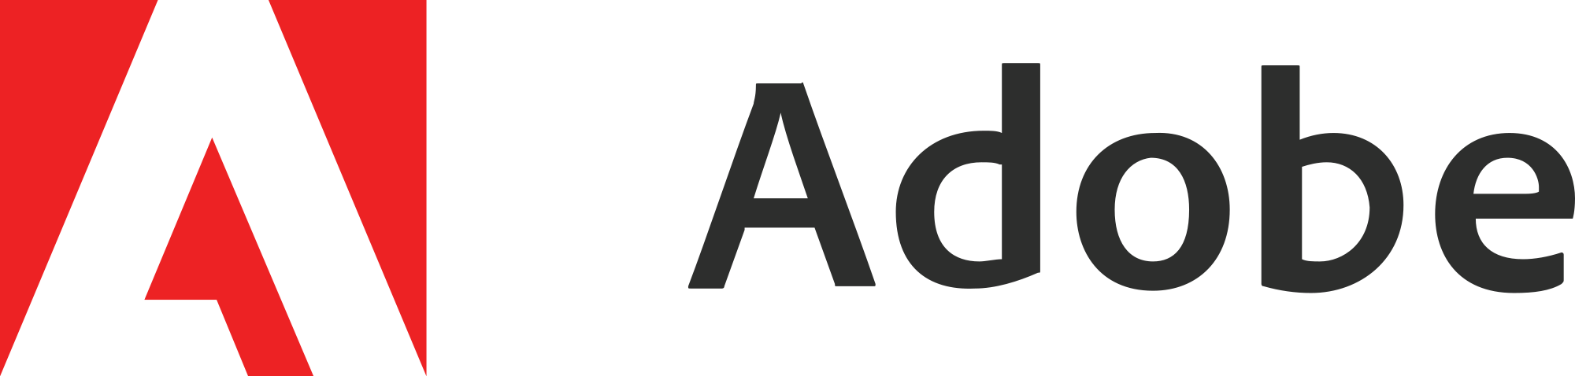

Thousands of Organizations Run Mission Critical Workloads on Amazon Redshift
Notes:
This is a sampling of our many customers.
Discuss industry examples.

Slide 10

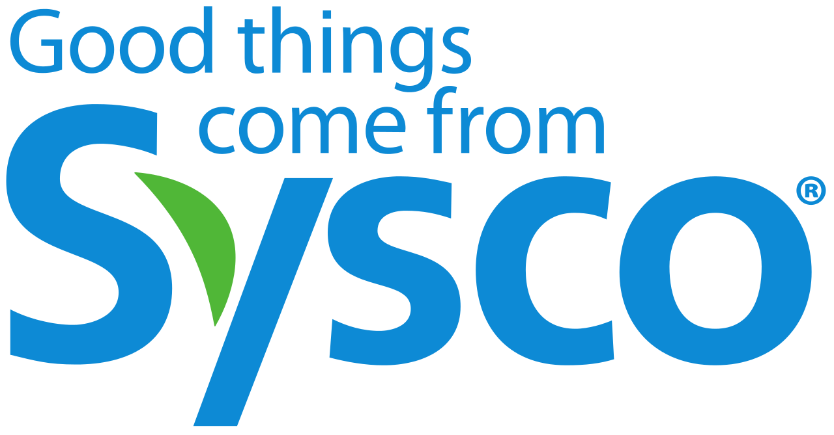
Sysco is the leader in selling, marketing, and distributing food.
Challenge:
Large volumes of data in multiple systems. Also, high costs from maintaining on-premises EDW deployment.
Solution:
Migrated their on-premises solution to the cloud with Redshift, S3, EMR, and Athena
Notes:
Sysco moved from multiple data warehouses to an AWS ecosystem, including Amazon Redshift, Amazon EMR, AWS Data Pipeline, and more.. They gained agile insight across their business.
About Sysco Foods:
Sysco Corporation is an American multinational corporation involved in marketing and distributing food products to restaurants, healthcare and educational facilities, hotels and inns, and other foodservice and hospitality businesses.
By bringing the data to S3 from various sources, including niche datamarts such as Lexington, and EDW into S3, the true potential of the data was unlocked by allowing different personas to use the ecosystem in new ways
Data scientists are using Apache Zeppelin,Apache Spark on EMR to build notebooks and Adhoc data analysis.
Business users and SQL analysts are using Amazon Athena to perform Adhoc queries that are not pre-­optimized for Redshift.
Redshift Spectrum is being used for any temporary surge in reporting needs for a specific area
Rest API standards are being deployed to enable data apps and data products

Slide 11

Analytics on the Data Lake
Sysco is the leader in selling, marketing, & distributing food
Challenge: large volumes of data in multiple systems
Consolidated data into a single S3 data lake
Data scientists use EMR notebooks, Athena & Amazon Redshift Spectrum used by business users for reporting
Redshift
Spectrum
Marketing data source
S3
ETL process
Redshift
S3
Athena
Other source systems
Ingest raw data from multiple sources
Data preparation
Transformed data
EMR
Notes:
Sysco moved from multiple data warehouses to an AWS ecosystem, including Amazon Redshift, Amazon EMR, AWS Data Pipeline, and more.. They gained agile insight across their business.
About Sysco Foods:
Sysco Corporation is an American multinational corporation involved in marketing and distributing food products to restaurants, healthcare and educational facilities, hotels and inns, and other foodservice and hospitality businesses.
By bringing the data to S3 from various sources, including niche datamarts such as Lexington, and EDW into S3, the true potential of the data was unlocked by allowing different personas to use the ecosystem in new ways
Data scientists are using Apache Zeppelin,Apache Spark on EMR to build notebooks and Adhoc data analysis.
Business users and SQL analysts are using Amazon Athena to perform Adhoc queries that are not pre-­optimized for Redshift.
Redshift Spectrum is being used for any temporary surge in reporting needs for a specific area
Rest API standards are being deployed to enable data apps and data products

Slide 12
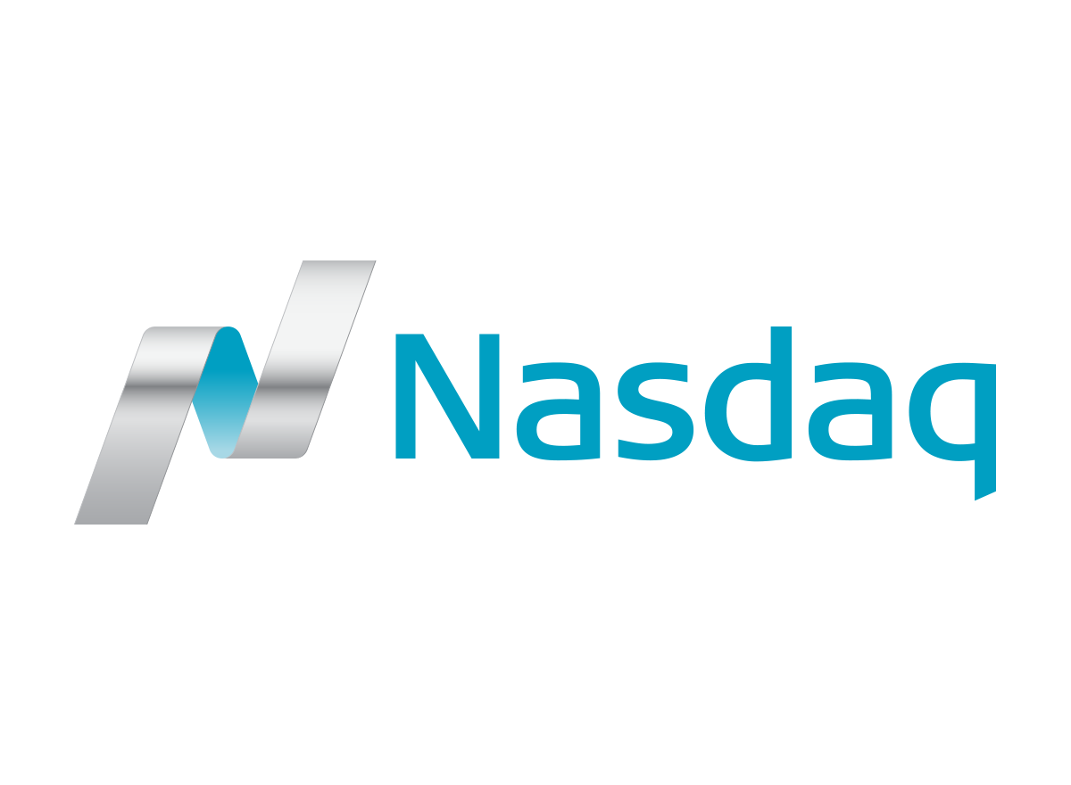

Nasdaq operates financial exchanges around the world, and processes large volumes of data.
Challenge:
Nasdaq wanted to make their large historical data footprint available to analyze as a single dataset.
Solution:
Use Amazon Redshift for interactive querying
Use Amazon S3 as a Data Lake, and Presto on EMR to process historical data
Notes:
The NASDAQ group of companies operates financial exchanges around the world, and processes large volumes of data every day. Each trading day, around 5B rows get inserted, containing orders, trades, and quotes. NASDAQ wanted to make their historical data footprint which previously existed in a large number of disparate systems available to analyze as a single data lake. NASDAQ solved this by deploying Amazon S3 as their data lake, Presto on Amazon EMR to process historical data, and Amazon Redshift for fast, interactive queries supporting a wide range of users with different skillsets. This has saved NASDAQ in costs and time-to-market. By leveraging the AWS services, NASDAQ has avoided the need to buy expensive hardware and were able to decrease their time to market threefold. They can now support years of historical tick data down to the millisecond in their data lake with the option to increase the amount of data stored indefinitely.
This is a guest post by Nate Sammons, a Principal Architect for Nasdaq
The Nasdaq group of companies operates financial exchanges around the world and processes large volumes of data every day. We run a wide variety of analytic and surveillance systems, all of which require access to essentially the same data sets.
The Nasdaq Group has been a user of Amazon Redshift since it was released and we are extremely happy with it. We’ve discussed our usage of that system at re:Invent several times, the most recent of which was FIN401 Seismic Shift: Nasdaq’s Migration to Amazon Redshift. Currently, our system is moving an average of 5.5 billion rows into Amazon Redshift every day (14 billion on a peak day in October of 2014).
In addition to our Amazon Redshift data warehouse, we have a large historical data footprint that we would like to access as a single, gigantic data set. Currently, this historical archive is spread across a large number of disparate systems, making it difficult to use. Our aim for a new, unified warehouse platform is two-fold: increase the accessibility of this historic data set to a growing number of internal groups at Nasdaq and to gain cost efficiencies in the process. For this platform, Hadoop is a clear choice: it supports a number of different SQL and other interfaces for accessing data and has an active and growing ecosystem of tools and projects.
Why Amazon S3 and Amazon EMR?
A major architectural tenet of our new warehouse platform is the separation of storage and compute resources. In traditional Hadoop deployments, scaling storage capacity typically requires also scaling compute capacity, and any change to the ratio of compute to storage involves modifying hardware. In our use case for a long-term historical archive, data that is not accessed frequently in HDFS would still require always-on, attached compute resources on each node in the cluster.
Additionally, the default replication factor for HDFS is 3, meaning that every block of data is present on three nodes in the cluster. This provides some level of durability, but it means you must buy three times the amount of disk needed when expanding storage capacity on your cluster. It also introduces hotspots: if a given piece of data is present on only three nodes in your cluster but is accessed very frequently, you must either duplicate it or deal with certain compute nodes becoming hotspots.
We can avoid these problems by using Amazon S3 and Amazon EMR, allowing us to separate compute and storage for our data warehouse and scale each independently. There are no hotspots because every object in S3 is exactly as accessible as any other object. Amazon S3 has practically infinite scalability, 11 9’s of durability (99.999999999%), automatic cross-data center replication, straightforward cross-region replication, and low cost. With additional integration with IAM policies, S3 provides a storage solution with fine-grained access control across multiple AWS accounts. For these reasons, Netflix and others have proven that it’s a viable platform for data warehousing. Also, new services like AWS Lambda, which can execute arbitrary code in response to S3 events, will open up additional possibilities.
Launching Clusters with EMR
EMR makes it easy to deploy and manage Hadoop clusters. We can grow and shrink clusters as needed, and shut them down over weekends or holidays. Everything runs inside a VPC where we have tight control on network access. IAM role integration makes pervasive access control easy. Critically, EMRFS, which is an HDFS-compliant filesystem to access objects in S3, allows that access control to flow through to our data storage layer in S3.
We are able to run multiple data access layers on top of the same storage system by using multiple EMR clusters, and those access layers can be isolated and do not need to compete for compute resources. If a certain job needs an unusually large amount of RAM on each node, we can simply run a cluster of memory optimized nodes instead of a cluster with a more balanced CPU to memory ratio. We can run experimental clusters without the need to modify the “main” production cluster for a given internal customer. Cost allocation is easy as well, as we can tag EMR clusters to track costs or run them in entirely separate AWS accounts as needed.
Because it’s so easy to manage clusters, we’re able to experiment with new data access layers and run large-scale POCs without an up-front investment in new hardware or spending costly time configuring all the various moving parts involved with running Hadoop clusters. This is similar to our experience with Amazon Redshift: before Amazon Redshift, we would never have even thought about duplicating a 100+ TB production database for an experiment. It would have meant months of delay in ordering hardware, setup, data migration, etc. – now we can do that over a weekend and “throw it away” when we’re done experimenting. It opens up new possibilities that weren’t really conceivable in the past.
With our new data warehouse, our aim is to build a platform that is useful and accessible to a wide range of users with different skill sets. The primary interface is through SQL; we are evaluating Spark SQL, Presto, and Drill, though we are also looking at alternatives and non-SQL capabilities. The Hadoop community is moving very quickly, and because there’s no such thing as a one-size-fits-all query tool, our aim is to support any Hadoop ecosystem analytics and data access application that our customers want to use. EMR and EMRFS’ connectivity to S3 make this possible.
Security Requirements and Amazon S3 Client-Side Encryption
The Nasdaq Group has a group-wide, highly engaged, internal information security team with strict policies and standards regarding data and applications. Because of the sensitivity of this data, it must be encrypted when stored and when in transit. Additionally, the encryption keys must be rooted in a cluster of HSMs (hardware security modules) physically located in Nasdaq facilities. We use the same brand and model of HSM as the AWS CloudHSM service (SafeNet Luna SA), which also allows us to store Amazon Redshift cluster master keys in our own HSMs. For simplicity, we’ll call this the Nasdaq KMS, as its functionality is similar to that of the AWS Key Management Service (AWS KMS).
Recently, EMR launched a feature in EMRFS to allow S3 client-side encryption using customer keys, which utilizes the S3 encryption client’s envelope encryption. EMRFS allows us to write a thin adapter by implementing the EncryptionMaterialsProvider interface from the AWS SDK so that when EMRFS reads or writes an object in S3 we get a callback to supply the encryption key. This is a clean, low-level hook that lets us run most applications without the need to integrate any encryption logic.
Because EMRFS is an implementation of the HDFS interface (it’s called when you use the scheme “s3://” in EMR), none of the layers above need to be aware of the encryption. It’s also low enough in the stack that it acts as a catch-all, making it nearly impossible to forget to integrate encryption. It’s important to note that seek() functionality also works on encrypted files in S3, which is a critical performance feature for many Hadoop ecosystem file formats.
Using a Custom Encryption Materials Provider
For our materials provider, we built an implementation that communicates with the Nasdaq KMS (see the “Code Sample” section below for more information). EMR pulls our implementation .jar file from S3, places it on each node of the cluster, and configures EMRFS to use our materials provider in the emrfs-site.xml configuration file on the cluster. We can do this easily from the AWS CLI by specifying the following arguments when creating a cluster:
–emrfs Encryption=ClientSide,ProviderType=Custom,CustomProviderLocation=s3://mybucket/myfolder/myprovider.jar,CustomProviderClass=providerclassname
An s3get and a configure-hadoop bootstrap action will be automatically added and configured to copy the provider jar file and configure emrfs-site.xml, respectively. The s3get bootstrap action uses the Instance Profile assigned to the cluster when making the get request to S3, so you can limit access to your provider jar. And, if your provider class implements Configurable from the Hadoop API, you will be also able to pull configuration values from the Hadoop configuration XML files at runtime.
The “x-amz-matdesc” user metadata field on an S3 object is used to store the “materials description” so that your provider knows what key to retrieve. This field contains a JSON version of a Map<String,String> which is passed to the provider implementation when requesting a key for an existing object. When a key is requested to write a new object, that same map is supplied through the EncryptionMaterials object, which itself has a Map<String,String> as a description. We rotate encryption keys often, so we use this map to store a unique identifier for the encryption key used for the S3 object. The key identifier itself is not considered sensitive information, so it can be stored in object metadata in S3.
Data Ingest Workflow
Nasdaq already has a mature data ingest system that was developed to support our Amazon Redshift efforts. This system is built on a workflow engine that orchestrates approximately 30,000 operations each day and uses MySQL as a persistent store for state information.
Most of those operations execute multiple steps with the following general pattern:
Retrieve data from another system via JDBC, SMB, FTP, SFTP, etc.
Validate data for syntax and correctness to ensure that the schema hasn’t changed, that we aren’t missing data, etc.
Convert the data into Parquet or ORC files.
Upload files to S3 using S3 client-side encryption.
Our data ingest system itself has no knowledge of HDFS. We write data directly to S3 using a similar EncryptionMaterialsProvider implementation that doesn’t use the Hadoop Configuration interface hooks. This is important: there is nothing special about data read or written through EMRFS. It is all just S3, and as long as your materials provider can determine the correct encryption key to use, EMR can operate seamlessly on your encrypted objects in S3.
https://aws.amazon.com/blogs/big-data/nasdaqs-architecture-using-amazon-emr-and-amazon-s3-for-ad-hoc-access-to-a-massive-data-set/

Slide 13
Nasdaq Uses AWS to Build a Data Lake
Migrate legacy on-premises warehouse to Amazon Redshift
4.8B rows inserted per trading day (orders, trades, quotes)
Ingest data from multiple sources, validates, and stages in S3
Redshift reads data out of S3 for fast queries
Presto on EMR and S3 used for analysis of massive historical data set
Flat files
EMR
SQL Clients
S3
Operational Databases
Redshift
Data from all 7 exchanges operated by Nasdaq (orders, quotes, trade executions)
Notes:
The NASDAQ group of companies operates financial exchanges around the world, and processes large volumes of data every day. Each trading day, around 5B rows get inserted, containing orders, trades, and quotes. NASDAQ wanted to make their historical data footprint which previously existed in a large number of disparate systems available to analyze as a single data lake. NASDAQ solved this by deploying Amazon S3 as their data lake, Presto on Amazon EMR to process historical data, and Amazon Redshift for fast, interactive queries supporting a wide range of users with different skillsets. This has saved NASDAQ in costs and time-to-market. By leveraging the AWS services, NASDAQ has avoided the need to buy expensive hardware and were able to decrease their time to market threefold. They can now support years of historical tick data down to the millisecond in their data lake with the option to increase the amount of data stored indefinitely.
This is a guest post by Nate Sammons, a Principal Architect for Nasdaq
The Nasdaq group of companies operates financial exchanges around the world and processes large volumes of data every day. We run a wide variety of analytic and surveillance systems, all of which require access to essentially the same data sets.
The Nasdaq Group has been a user of Amazon Redshift since it was released and we are extremely happy with it. We’ve discussed our usage of that system at re:Invent several times, the most recent of which was FIN401 Seismic Shift: Nasdaq’s Migration to Amazon Redshift. Currently, our system is moving an average of 5.5 billion rows into Amazon Redshift every day (14 billion on a peak day in October of 2014).
In addition to our Amazon Redshift data warehouse, we have a large historical data footprint that we would like to access as a single, gigantic data set. Currently, this historical archive is spread across a large number of disparate systems, making it difficult to use. Our aim for a new, unified warehouse platform is two-fold: increase the accessibility of this historic data set to a growing number of internal groups at Nasdaq and to gain cost efficiencies in the process. For this platform, Hadoop is a clear choice: it supports a number of different SQL and other interfaces for accessing data and has an active and growing ecosystem of tools and projects.
Why Amazon S3 and Amazon EMR?
A major architectural tenet of our new warehouse platform is the separation of storage and compute resources. In traditional Hadoop deployments, scaling storage capacity typically requires also scaling compute capacity, and any change to the ratio of compute to storage involves modifying hardware. In our use case for a long-term historical archive, data that is not accessed frequently in HDFS would still require always-on, attached compute resources on each node in the cluster.
Additionally, the default replication factor for HDFS is 3, meaning that every block of data is present on three nodes in the cluster. This provides some level of durability, but it means you must buy three times the amount of disk needed when expanding storage capacity on your cluster. It also introduces hotspots: if a given piece of data is present on only three nodes in your cluster but is accessed very frequently, you must either duplicate it or deal with certain compute nodes becoming hotspots.
We can avoid these problems by using Amazon S3 and Amazon EMR, allowing us to separate compute and storage for our data warehouse and scale each independently. There are no hotspots because every object in S3 is exactly as accessible as any other object. Amazon S3 has practically infinite scalability, 11 9’s of durability (99.999999999%), automatic cross-data center replication, straightforward cross-region replication, and low cost. With additional integration with IAM policies, S3 provides a storage solution with fine-grained access control across multiple AWS accounts. For these reasons, Netflix and others have proven that it’s a viable platform for data warehousing. Also, new services like AWS Lambda, which can execute arbitrary code in response to S3 events, will open up additional possibilities.
Launching Clusters with EMR
EMR makes it easy to deploy and manage Hadoop clusters. We can grow and shrink clusters as needed, and shut them down over weekends or holidays. Everything runs inside a VPC where we have tight control on network access. IAM role integration makes pervasive access control easy. Critically, EMRFS, which is an HDFS-compliant filesystem to access objects in S3, allows that access control to flow through to our data storage layer in S3.
We are able to run multiple data access layers on top of the same storage system by using multiple EMR clusters, and those access layers can be isolated and do not need to compete for compute resources. If a certain job needs an unusually large amount of RAM on each node, we can simply run a cluster of memory optimized nodes instead of a cluster with a more balanced CPU to memory ratio. We can run experimental clusters without the need to modify the “main” production cluster for a given internal customer. Cost allocation is easy as well, as we can tag EMR clusters to track costs or run them in entirely separate AWS accounts as needed.
Because it’s so easy to manage clusters, we’re able to experiment with new data access layers and run large-scale POCs without an up-front investment in new hardware or spending costly time configuring all the various moving parts involved with running Hadoop clusters. This is similar to our experience with Amazon Redshift: before Amazon Redshift, we would never have even thought about duplicating a 100+ TB production database for an experiment. It would have meant months of delay in ordering hardware, setup, data migration, etc. – now we can do that over a weekend and “throw it away” when we’re done experimenting. It opens up new possibilities that weren’t really conceivable in the past.
With our new data warehouse, our aim is to build a platform that is useful and accessible to a wide range of users with different skill sets. The primary interface is through SQL; we are evaluating Spark SQL, Presto, and Drill, though we are also looking at alternatives and non-SQL capabilities. The Hadoop community is moving very quickly, and because there’s no such thing as a one-size-fits-all query tool, our aim is to support any Hadoop ecosystem analytics and data access application that our customers want to use. EMR and EMRFS’ connectivity to S3 make this possible.
Security Requirements and Amazon S3 Client-Side Encryption
The Nasdaq Group has a group-wide, highly engaged, internal information security team with strict policies and standards regarding data and applications. Because of the sensitivity of this data, it must be encrypted when stored and when in transit. Additionally, the encryption keys must be rooted in a cluster of HSMs (hardware security modules) physically located in Nasdaq facilities. We use the same brand and model of HSM as the AWS CloudHSM service (SafeNet Luna SA), which also allows us to store Amazon Redshift cluster master keys in our own HSMs. For simplicity, we’ll call this the Nasdaq KMS, as its functionality is similar to that of the AWS Key Management Service (AWS KMS).
Recently, EMR launched a feature in EMRFS to allow S3 client-side encryption using customer keys, which utilizes the S3 encryption client’s envelope encryption. EMRFS allows us to write a thin adapter by implementing the EncryptionMaterialsProvider interface from the AWS SDK so that when EMRFS reads or writes an object in S3 we get a callback to supply the encryption key. This is a clean, low-level hook that lets us run most applications without the need to integrate any encryption logic.
Because EMRFS is an implementation of the HDFS interface (it’s called when you use the scheme “s3://” in EMR), none of the layers above need to be aware of the encryption. It’s also low enough in the stack that it acts as a catch-all, making it nearly impossible to forget to integrate encryption. It’s important to note that seek() functionality also works on encrypted files in S3, which is a critical performance feature for many Hadoop ecosystem file formats.
Using a Custom Encryption Materials Provider
For our materials provider, we built an implementation that communicates with the Nasdaq KMS (see the “Code Sample” section below for more information). EMR pulls our implementation .jar file from S3, places it on each node of the cluster, and configures EMRFS to use our materials provider in the emrfs-site.xml configuration file on the cluster. We can do this easily from the AWS CLI by specifying the following arguments when creating a cluster:
–emrfs Encryption=ClientSide,ProviderType=Custom,CustomProviderLocation=s3://mybucket/myfolder/myprovider.jar,CustomProviderClass=providerclassname
An s3get and a configure-hadoop bootstrap action will be automatically added and configured to copy the provider jar file and configure emrfs-site.xml, respectively. The s3get bootstrap action uses the Instance Profile assigned to the cluster when making the get request to S3, so you can limit access to your provider jar. And, if your provider class implements Configurable from the Hadoop API, you will be also able to pull configuration values from the Hadoop configuration XML files at runtime.
The “x-amz-matdesc” user metadata field on an S3 object is used to store the “materials description” so that your provider knows what key to retrieve. This field contains a JSON version of a Map<String,String> which is passed to the provider implementation when requesting a key for an existing object. When a key is requested to write a new object, that same map is supplied through the EncryptionMaterials object, which itself has a Map<String,String> as a description. We rotate encryption keys often, so we use this map to store a unique identifier for the encryption key used for the S3 object. The key identifier itself is not considered sensitive information, so it can be stored in object metadata in S3.
Data Ingest Workflow
Nasdaq already has a mature data ingest system that was developed to support our Amazon Redshift efforts. This system is built on a workflow engine that orchestrates approximately 30,000 operations each day and uses MySQL as a persistent store for state information.
Most of those operations execute multiple steps with the following general pattern:
Retrieve data from another system via JDBC, SMB, FTP, SFTP, etc.
Validate data for syntax and correctness to ensure that the schema hasn’t changed, that we aren’t missing data, etc.
Convert the data into Parquet or ORC files.
Upload files to S3 using S3 client-side encryption.
Our data ingest system itself has no knowledge of HDFS. We write data directly to S3 using a similar EncryptionMaterialsProvider implementation that doesn’t use the Hadoop Configuration interface hooks. This is important: there is nothing special about data read or written through EMRFS. It is all just S3, and as long as your materials provider can determine the correct encryption key to use, EMR can operate seamlessly on your encrypted objects in S3.
https://aws.amazon.com/blogs/big-data/nasdaqs-architecture-using-amazon-emr-and-amazon-s3-for-ad-hoc-access-to-a-massive-data-set/

Slide 14
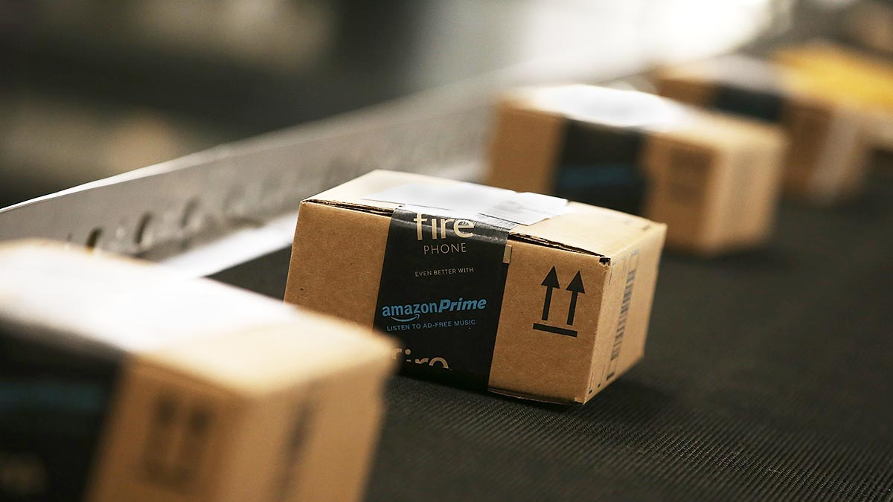

Amazon.com’s vision is to be the earth’s most customer—centric company; where people can find anything they want to buy online.
Challenge:
Load 500K+ transactions each day, and serve 300K+ queries/extracts each day from Amazon businsses (Amazon.com, Amazon Prime, Amazon Music, Amazon Alexa, Amazon Video, and Twitch).
Solution:
Land data in S3 as a data lake
Use Redshift as preferred SQL based analysis by business users, and EMR for machine learning
Notes:
Amazon’s consumer business continues to grow, and so does the volume of data and the number and complexity of the analytics done in support of the business. In this session, we talk about how Amazon.com uses AWS technologies to build a scalable environment for data and analytics. We look at how Amazon is evolving the world of data warehousing with a combination of a data lake and parallel, scalable compute engines such as Amazon EMR and Amazon Redshift.
https://www.youtube.com/watch?v=lWK96BNx3Qk&feature=youtu.be

Slide 15
Amazon.com Uses AWS for Data Lakes & Analytics
DynamoDB capturing all Amazon.com transactions
Everything from DynamoDB, RDS PostgreSQL and Kinesis fed to a S3 data lake
Glue used to catalog the data
Redshift used for all SQL-based queries, and EMR for all machine learning and big data processing
End-users use QuickSight for visualizations
DynamoDB
QuickSight
Redshift
Catalog
PostgreSQL
S3
AWS Glue
Athena
EMR
Kinesis
Machine Learning
Notes:
https://www.youtube.com/watch?v=lWK96BNx3Qk&feature=youtu.be
Amazon.com’s vision is to be the earth’s most customer—centric company; where people can find anything they want to buy online.
Challenge:
Load 500K+ transactions each day, and serve 300K+ queries/extracts each day from Amazon businsses (Amazon.com, Amazon Prime, Amazon Music, Amazon Alexa, Amazon Video, and Twitch).
Solution:
Land data in S3 as a data lake
Use Redshift as preferred SQL based analysis by business users, and EMR for machine learning

Slide 16
Redshift Best Practices

Slide 17

Designing Tables

Slide 18
Designing Tables Distribution Key (DISTKEY)
CREATE TABLE deep_dive (
aid INT --audience_id
,loc CHAR(3) --location
,dt DATE SORTKEY --date
)DISTKEY (loc);
SELECT *
FROM deep_dive
WHERE loc = SYD
SELECT *
FROM deep_dive
WHERE aid = 1
1 slice
4 slices
aid | loc | dt
1 | SYD | 2018-04-01
2 | SYD | 2018-05-14
3 | SYD | 2018-09-01
4 | SYD | 2018-09-14
aid | loc | dt
1 | MEL | 2018-04-01
2 | MEL | 2018-05-14
3 | MEL | 2018-09-01
4 | MEL | 2018-09-14
aid | loc | dt
1 | BNE | 2018-04-01
2 | BNE | 2018-05-14
3 | BNE | 2018-09-01
4 | BNE | 2018-09-14
aid | loc | dt
1 | PER | 2018-04-01
2 | PER | 2018-05-14
3 | PER | 2018-09-01
4 | PER | 2018-09-14

Slide 19
Designing Tables Sort Key (SORTKEY)
CREATE TABLE deep_dive (
aid INT --audience_id
,loc CHAR(3) --location
,dt DATE --date
) diststyle all
interleaved sortkey (aid, loc);
SELECT *
FROM deep_dive
WHERE loc = SYD
SELECT *
FROM deep_dive
WHERE aid = 1
2 slices
2 slices
aid | loc | dt
1 | SYD | 2018-04-01
1 | MEL | 2018-05-14
2 | SYD | 2018-09-01
2 | MEL | 2018-09-14
aid | loc | dt
1 | BNE | 2018-04-01
1 | PER | 2018-05-14
2 | BNE | 2018-09-01
2 | PER | 2018-09-14
aid | loc | dt
3 | SYD | 2018-04-01
3 | MEL | 2018-05-14
4 | SYD | 2018-09-01
4 | MEL | 2018-09-14
aid | loc | dt
3 | BNE | 2018-04-01
3 | PER | 2018-05-14
4 | BNE | 2018-09-01
4 | PER | 2018-09-14
Notes:
Depends on query, if timestamp is used often design sort key around dt as min/max allows skipping blocks (see zone maps)

Slide 20
Designed for I/O Reduction
CREATE TABLE deep_dive (
aid INT --audience_id
,loc CHAR(3) --location
,dt DATE --date
);
Columnar storage
Data compression
Zone maps
aid | loc | dt
1 | SYD | 2018-09-01
2 | MEL | 2018-09-14
3 | SYD | 2018-04-01
4 | MEL | 2018-05-14
SELECT count(dt)
FROM deep_dive;
aid
loc
dt
Accessing dt with row storage:
Need to read everything
Unnecessary I/O

Slide 21
Designed for I/O Reduction
CREATE TABLE deep_dive (
aid INT --audience_id
,loc CHAR(3) --location
,dt DATE --date
);
Columnar storage
Data compression
Zone maps
aid | loc | dt
1 | SYD | 2018-09-01
2 | MEL | 2018-09-14
3 | SYD | 2018-04-01
4 | MEL | 2018-05-14
SELECT count(dt)
FROM deep_dive;
aid
loc
dt
Accessing dt with columnar storage
Only scan blocks for relevant column

Slide 22
Designed for I/O Reduction
CREATE TABLE deep_dive (
aid INT ENCODE LZO
,loc CHAR(3) ENCODE BYTEDICT
,dt DATE ENCODE RUNLENGTH
);
Columnar storage
Data compression
Zone maps
aid | loc | dt
1 | SYD | 2018-09-01
2 | MEL | 2018-09-14
3 | SYD | 2018-04-01
4 | MEL | 2018-05-14
aid
loc
dt
Columns grow and shrink independently
Reduces storage requirements
Reduces I/O
Notes:
Compression ZSTD (IMDB 40% more data)

Slide 23
Designed for I/O Reduction
CREATE TABLE deep_dive (
aid INT --audience_id
,loc CHAR(3) --location
,dt DATE --date
);
Columnar storage
Data compression
Zone maps
aid | loc | dt
1 | SYD | 2018-09-01
2 | MEL | 2018-09-14
3 | SYD | 2018-04-01
4 | MEL | 2018-05-14
aid
loc
dt
In-memory block metadata
Contains per-block MIN and MAX value
Effectively prunes blocks which cannot contain data for a given query
Eliminates unnecessary I/O

Slide 24


Zone Maps
SELECT COUNT(*) FROM deep_dive WHERE dt = '09-JUNE-2018'
Unsorted Table
Sorted By Date
MIN: 01-JUNE-2018
MAX: 06-JUNE-2018
MIN: 01-JUNE-2018
MAX: 20-JUNE-2018
MIN: 08-JUNE-2018
MAX: 30-JUNE-2018
MIN: 07-JUNE-2018
MAX: 12-JUNE-2018
MIN: 12-JUNE-2018
MAX: 20-JUNE-2018
MIN: 13-JUNE-2018
MAX: 18-JUNE-2018
MIN: 02-JUNE-2018
MAX: 25-JUNE-2018
MIN: 19-JUNE-2018
MAX: 24-JUNE-2018
Notes:
Sorted columns enable fetching the minimum number of blocks required for query execution. In this example, an unsorted table al most leads to a full table scan O(N) and a sorted table leads to one block scanned O(1).
We know min/max range for the blocks so redshift skips them

Slide 25
Redshift Best Practices
New!
Amazon Redshift Advisor
Best Practices for Designing Tables, Data and Query
https://docs.aws.amazon.com/redshift/latest/dg/best-practices.html

Slide 26
Hands on Lab
https://github.com/saltysoup/pfizer/tree/master/Module-2_IntroRedshift

Slide 27

Query All Your Data Redshift Spectrum Feature Extends Redshift Queries to an Amazon S3 Data Lake
Amazon
Redshift Spectrum
Directly query exabytes in S3, no loading required
Query across Redshift and S3
Scale compute and storage separately
High concurrency
Support for Parquet, ORC, Avro, CSV, JSON, Grok, and other open file formats
Pay only for the amount of data scanned
Amazon S3
Redshift Query Engine
Data Lake
Redshift Data
Notes:
Redshift Spectrum gives you the best of both worlds.
If you need to run frequent queries on the same data, you can normalize it, store it in Redshift, and get all the benefits of a fully featured and fully managed data warehouse for storing and querying structured data. At the same time, you can keep your unstructured data in an S3 data lake, and extend your Redshift queries across the universe of data you store in S3.
With Redshift Spectrum, you can run Redshift queries on S3 data on its own, or you can run queries that join together data in S3 with data already in your Redshift data warehouse. Redshift Spectrum gives you the freedom to store your data where you want, in the format you want, and have it available for processing when you need it.
Redshift Spectrum applies sophisticated query optimization, scaling processing across thousands of nodes so results are fast – even with large data sets and complex queries.

Slide 28
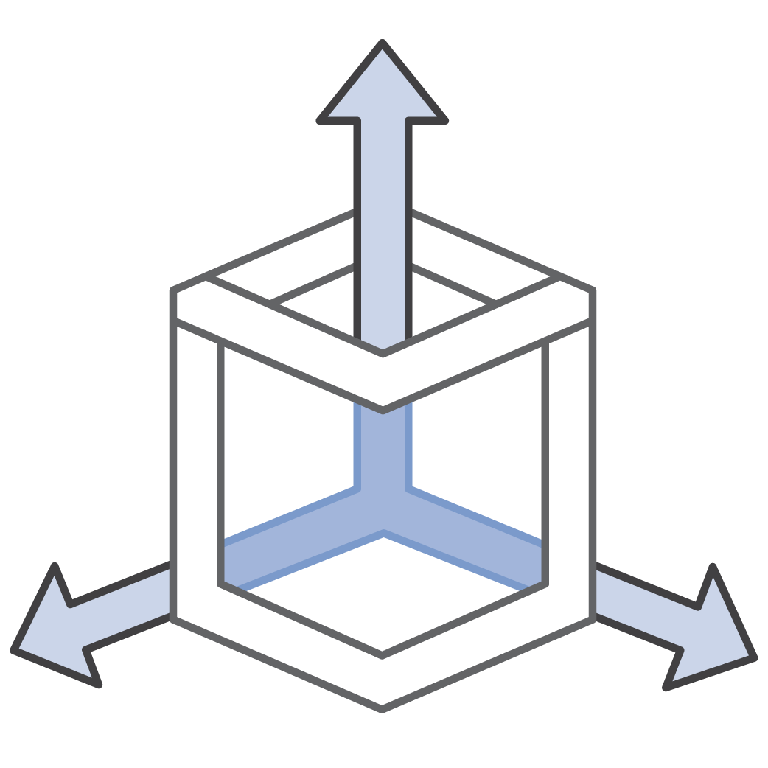





External Tables with Redshift Spectrum Run SQL queries directly against data in S3 using thousands of nodes
High concurrency: Multiple clusters access same data
No ETL: Query data in-place using open file formats
Full Amazon Redshift SQL support
S3
SQL
Fast @ exabyte scale
Elastic & highly available
On-demand, pay-per-query

Slide 29

Querying with Redshift Spectrum Understands ANSI standard SQL
Spectrum external tables seamlessly integrate with your existing SQL & BI apps
Support for complex joins, nested queries & window functions
Support for data partitioned in S3 by any key
Date, Time and any other custom keys
e.g., Year, Month, Day, Hour

Slide 30

Querying with Redshift Spectrum External Tables are Fast
Leverages Amazon Redshift’s advanced cost-based optimizer
Pushes down projections, filters, aggregations and join reduction
Dynamic partition pruning to minimize data processed
Automatic parallelization of query execution against S3 data
Efficient join processing within the Amazon Redshift cluster

Slide 31
Querying with Redshift Spectrum External Tables are Cost-Effective
You pay for your Amazon Redshift cluster plus $5 per TB scanned from S3
Each query can leverage 1000s of Spectrum nodes
You can reduce the TB scanned and improve query performance by:
- Partitioning data
- Using a columnar file format
- Compressing data

Slide 32

Amazon Redshift
Query
SELECT COUNT(*)
FROM S3.EXT_TABLE
GROUP BY…
1
Life of a Query
JDBC/ODBC
Query is optimized and compiled at the leader node. Determine what gets run locally and what goes to Amazon Redshift Spectrum
9
Result is sent back to client
Amazon
Redshift
2
3
Query plan is sent to all compute nodes
Final aggregations and joins with local Amazon Redshift tables done in-cluster
8
4
Compute nodes obtain partition info from Data Catalog; dynamically prune partitions
Amazon Redshift Spectrum projects, filters, joins and aggregates
5
Each compute node issues multiple requests to the Amazon Redshift Spectrum layer
7
Redshift Spectrum Scale-out serverless compute
6
Amazon Redshift Spectrum nodes scan your S3 data
Amazon S3 Exabyte-scale object storage
AWS Glue Data Catalog
Notes:
If we take a look behind the scenes, we have the Redshift cluster in green and the purple boxes are the autoscaling, multi tenant, spectrum fleet of Redshift Spectrum compute nodes.
This architecture provides high levels of parallelism to execute your queries directly on S3 data, with unlimited concurrency.
Separating storage + compute gives you the option to load your data in your local Redshift cluster, keep your data in S3 and analyze it with Redshift Spectrum, or a combination of both – e.g. keep frequently accessed data in Redshift, and store less frequently accessed data in S3.

Slide 33
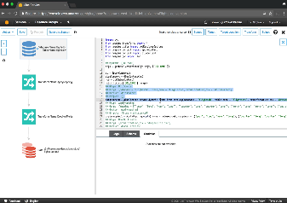
Amazon Redshift is Integrated AWS Glue: Serverless Data Catalog & ETL Service
Data Catalog
ETL Job authoring
Automatically discovers data and stores schema
Data is immediately searchable, and available to extract, transform, and load (ETL)
Automatically generates customizable ETL code
Schedules and runs your ETL jobs
Serverless
Discover data and extract schema
Auto-generates customizable ETL code in Python or Scala
Notes:
AWS Glue is a fully managed extract, transform, and load (ETL) service that makes it easy for customers to prepare and load their data for analytics. You can create and run an ETL job with a few clicks in the AWS Management Console. You simply point AWS Glue to your data stored on AWS, and AWS Glue discovers your data and stores the associated metadata (e.g. table definition and schema) in the AWS Glue Data Catalog. Once cataloged, your data is immediately searchable, queryable, and available for ETL. AWS Glue generates the code to execute your data transformations and data loading processes.
AWS Glue generates Python code that is customizable, reusable, and portable. Once your ETL job is ready, you can schedule it to run on AWS Glue's fully managed, scale-out Apache Spark environment. AWS Glue provides a flexible scheduler with dependency resolution, job monitoring, and alerting.
AWS Glue is serverless, so there is no infrastructure to buy, set up, or manage. It automatically provisions the environment needed to complete the job, and customers pay only for the compute resources consumed while running ETL jobs. With AWS Glue, data can be available for analytics in minutes.
Easy
AWS Glue automates much of the effort in building, maintaining, and running ETL jobs. AWS Glue crawls your data sources, identifies data formats, and suggests schemas and transformations. AWS Glue automatically generates the code to execute your data transformations and loading processes.
Integrated
AWS Glue is integrated across a wide range of AWS services. AWS Glue natively supports data stored in Amazon Aurora, Amazon RDS for MySQL, Amazon RDS for Oracle, Amazon RDS for PostgreSQL, Amazon RDS for SQL Server, Amazon Redshift, and Amazon S3, as well as MySQL, Oracle, Microsoft SQL Server, and PostgreSQL databases in your Virtual Private Cloud (Amazon VPC) running on Amazon EC2. AWS Glue provides out-of-the-box integration with Amazon Athena, Amazon EMR, Amazon Redshift Spectrum, and any Apache Hive Metastore-compatible application.
Serverless
AWS Glue is serverless. There is no infrastructure to provision or manage. AWS Glue handles provisioning, configuration, and scaling of the resources required to run your ETL jobs on a fully managed, scale-out Apache Spark environment. You pay only for the resources used while your jobs are running.
Developer Friendly
AWS Glue generates ETL code that is customizable, reusable, and portable, using familiar technology - Python and Spark. You can also import custom readers, writers and transformations into your Glue ETL code. Since the code AWS Glue generates is based on open frameworks, there is no lock-in. You can use it anywhere.

Slide 34












Amazon Redshift is Integrated Broad and deep portfolio, purpose-built for builders, single point of contact for AWS Support
Business Intelligence & Machine Learning
QuickSight
Amazon SageMaker
Amazon Comprehend
Relational Databases
Non-Relational Databases
Analytics
DynamoDB
DW | Big Data Processing | Interactive
Aurora
Redshift
EMR
Athena
ElastiCache (Redis, Memcached)
Real-time
RDS
Neptune
(Graph)
Elasticsearch Service
Kinesis Analytics
Data Lake
S3/Glacier
Glue
(ETL & Data Catalog)
Data Movement
Database Migration Service | Snowball | Snowmobile | Glue | Kinesis Data Firehose | Kinesis Data Streams
Notes:
AWS Big Data and Analytic services enable customers to easily run any analytic workload (batch, ad-hoc, real-time, IoT and predictive analytics) at any scale (GB to TB to PB to EB), in a secure fashion, at the lowest possible cost. AWS provides a highly scalable, available, secure, and cost effective data store that lets you store data in its native format and easily extract value from your data. (what people call a Data Lake). This is particularly true now that many customers see much of their new data created directly in the cloud, with Amazon S3 being home to the vast majority of it. With much more operating experience and scale, and a broader set analytics services available than anywhere else, S3 and our portfolio of Big Data & Analytics services is the clear number one choice for you to build your Data Lake and analytics solutions with.
Amazon Redshift is fully integrated with the AWS data lake and analytics ecosystem. Redshift Spectrum uses the Glue Data Catalog to query across your Redshift data warehouse and Amazon S3 data lake without unnecessary movement of data. Redshift Spectrum can query open file formats you already use, such as Parcquet, Avro, CSV, Grok, JSON, ORC, and more, directly in S3. This gives you the flexibility to store highly structured, frequently accessed data on Redshift local disks, keep exabytes of structured and unstructured data in S3, and query seamlessly across both to provide unique insights that you would not be able to obtain by querying independent data silos.

Slide 35





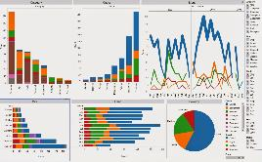















Amazon Redshift is Integrated Use Existing BI Tools
Use your existing cloud/on-premises Business Intelligence (BI) Tools
On Prem
Amazon QuickSight
JDBC/ODBC
Tool based native drivers
Amazon
Redshift
Existing or new BI tool
Notes:
With Redshift (and Redshift Spectrum), you can use Amazon QuickSight and many third-party Business Intelligence (BI) tools for reporting, dashboards, ad-hoc analysis, and visualization.
You can use the BI or SQL client tools of your choice.

Slide 36
When should I use Redshift vs Relational Databases?
Notes:
Redshift for OLAP, Relational DB for OLTP
OLAP: Online Analytical Processing – Designed for Data Analysis and optimized for reading through large data sets and aggregation (joins). Measure effectiveness by response time to complex queries.
OLTP: Online Transaction Processing – Designed for Data Processing and used for transactions like INSERTS, UPDATE, DELETE. Measure effectiveness by transactions per second

Slide 37
Hands on Lab
https://github.com/saltysoup/pfizer/tree/master/Module-3_RedshiftSpectrum

Slide 38
Quick Primer on Amazon Athena
Notes:
You simply put your Data in S3 and submit SQL against it

Slide 39
Amazon Athena is an interactive query service that makes it easy to analyze data directly from Amazon S3 using Standard SQL
Notes:
You simply put your Data in S3 and submit SQL against it

Slide 40
Amazon Athena
Decouple storage from compute
Serverless – No infrastructure or resources to manage
Pay only for data scanned (use columnar)
Secure – IAM for authentication; Encryption at rest & in transit
Built on powerful community supported OSS solutions
Notes:
Decouple storage from compute: allows customers to scale and manage storage and compute needs independently. The same data may have different compute needs such as EMR, Athena or Redshift
Serverless: Athena is fully managed, serverless service. No need to understand scaling or compute optimization
Pay only for data scanned: Customers are charged only by how much data was scanned by the query. There are several levers, compression, file formats, partitioning, to enable customer to reduce cost
Schema on read: customers can create different tables and run different queries representing many independent views of the data all while the underlying data remains unchanged
Secure: IAM for authN and authZ. query encrypted S3 buckets, write output to an encrypted S3 bucket. Critical for sensitive workloads
No proprietary file formats. Fully standard and open source file formats give customers freedom to use their data where/how they see fit – ties well with decoupled storage/compute
Hive/Presto are open source software products backed by large and active communities giving it stability, maturity and quick pace of innovation

Slide 41



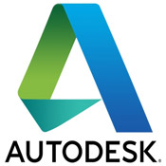






Customers Drive Product Decisions

Slide 42

Familiar Technologies Under the Covers
Used for DDL functionality
Complex data types
Multitude of formats
Supports data partitioning
Used for SQL Queries
In-memory distributed query engine
ANSI-SQL compatible with extensions

Slide 43
Athena vs. Redshift Spectrum vs Relational DB
Athena is serverless, with good performance
Redshift Spectrum enables Redshift clusters to query data both in the cluster and in S3
Redshift with Redshift Spectrum will provide the best performance but a Redshift cluster is required
If already using Redshift, extend with Spectrum
Ad-hoc queries vs OLAP vs OLTP
Notes:
Redshift Spectrum is 100% AWS code, Athena is based on open source

